Slide 1
Review and Analysis
12/11/2019

Slide 2
Our Idea
To implement an algorithm for automatic classification of text into positive or negative.
Graphical representation of the sentiment in the form of some chart
The good, the bad, the OMG!!

Slide 3








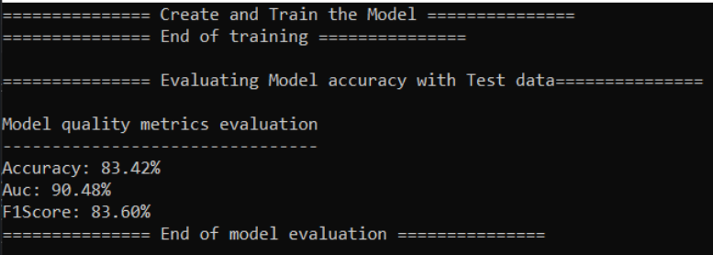


Review Analyzer System Overview
Supervised learning model using classification ML technique to classify between positive and negative comments
User Application
Training Data
Application will display customer sentiments in Graphical view for the reviews data specified
Reviews/ Sentiments Data Sources
Review Analyzer REST API

Slide 4
Technology used
ML.Net,Web API
Google API,Twitter API, Yelp API
HTML,Bootstrap

Slide 5
Business value
Product/Services reviews
Location reviews
Reviews on different Business Units
Analyze consumer attitudes, trends in different locations and remain competitive

Slide 6
What next
We can try different algorithms to add more business values

Slide 7
Demo
Zoom
Slack

